Slide 1

The Role of
Post-Merger Integration Manager

Slide 2

Post-Merger Integration Manager
Supported by the Steering Committee and the Integration Management Office (IMO), the Integration Manager is responsible for defining and implementing the integration strategy. This includes organizing and executing integration activities, guiding integration teams, monitoring milestones, reporting outcomes, and documenting lessons learned.
This role is a full-time position from the acquiring organization. The Integration Manager should be appointed no later than the transaction announcement and remain engaged through the end-state transition.
© 100-Day Advisors MandAPlaybook.com

Slide 3
The Integration Manager
helps ensure there is:
A Day 1 plan so the integration starts smoothly
An integration plan for each business function being integrated (i.e., Sales, Operations, Information Technology, Purchasing, HR, Tax, Finance, Legal, etc.)
A talent retention plan to incent key employees to stay on board
A communication plan for employees in both companies and all other stakeholders (i.e., customers, suppliers, vendors, partners, recruits, communities, etc.)
An integration progress tracking and reporting process for all functional integration leaders to follow
© 100-Day Advisors MandAPlaybook.com

Slide 4

Plan and conduct the Integration Team Kickoff Meeting so that all functional integration leaders understand their roles and responsibilities during the transition period
Assist with the launch of functional integration teams so they understand their charters and are organized for success
Brief the acquired management team and employees so that they understand the integration process and how it will impact them
Escalate issues requiring senior-level input so they are resolved quickly and effectively
Manage the interdependencies between functions so activities are prioritized and sequenced correctly
Evaluate the risks associated with an integration and mitigate them to the most reasonable extent possible
Ensure exit criteria are met
Document any handoffs to business line leaders at the end of the transition period
Capture lessons learned and recommendations for future acquisitions
Additional
Responsibilities of an
M&A Integration Manager include:
© 100-Day Advisors MandAPlaybook.com

Slide 5
The Integration Manager
should have the following traits and attributes:
Strategic thinking
Business savvy
Project management skills
Human relations skills
Team leadership skills
Conflict resolution skills
Communication skills
Self-confidence
Empathy
Respect for differences
Results-orientation
© 100-Day Advisors MandAPlaybook.com

Slide 6
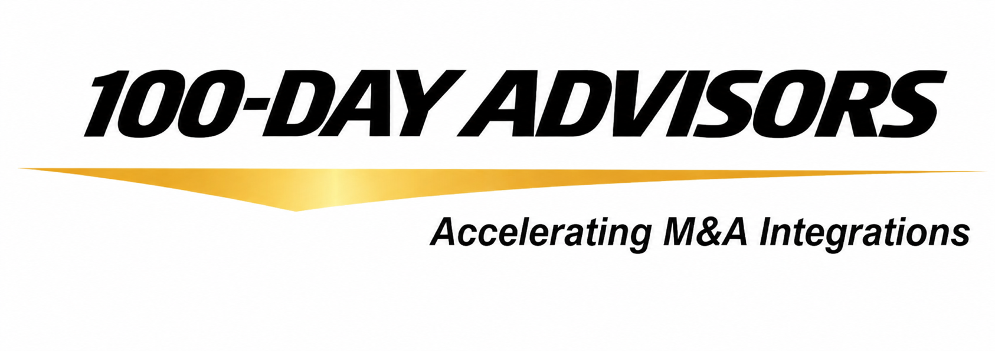


Consulting Inquiries:
Email: inquiries@100DayAdvisors.com
Website: MandAPlaybook.com/consulting
© 100-Day Advisors MandAPlaybook.com
6

